Slide 1

Food DeMAND FORECAST
Week 1 to Week 146 – Order Insights

Slide 2
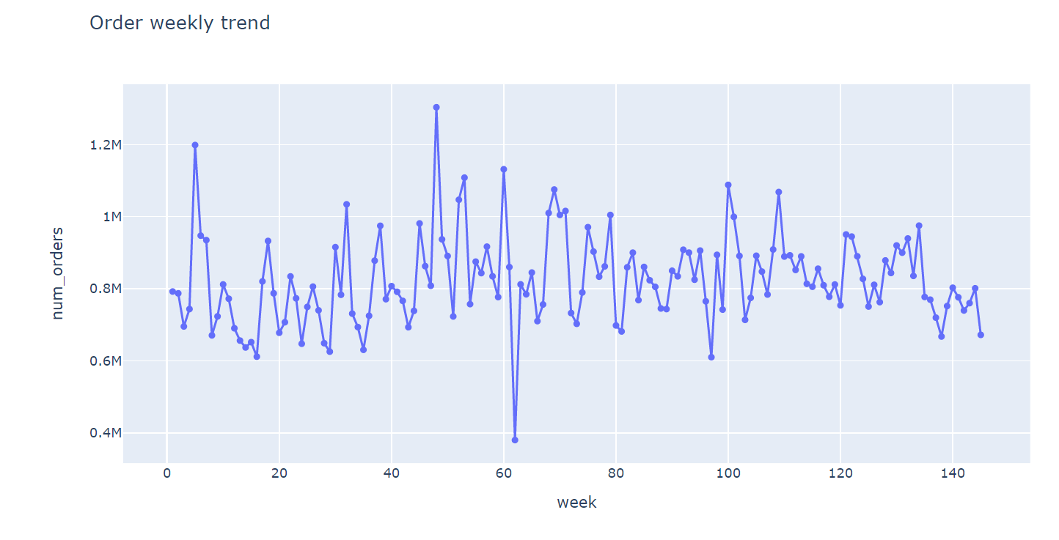
Weekly order trend
Weekly orders are fairly consistent, in the range of 600K to 1000K
Highest order was observed in week 48, around 1.3M. Lowest order in week 62, around 380K.

Slide 3
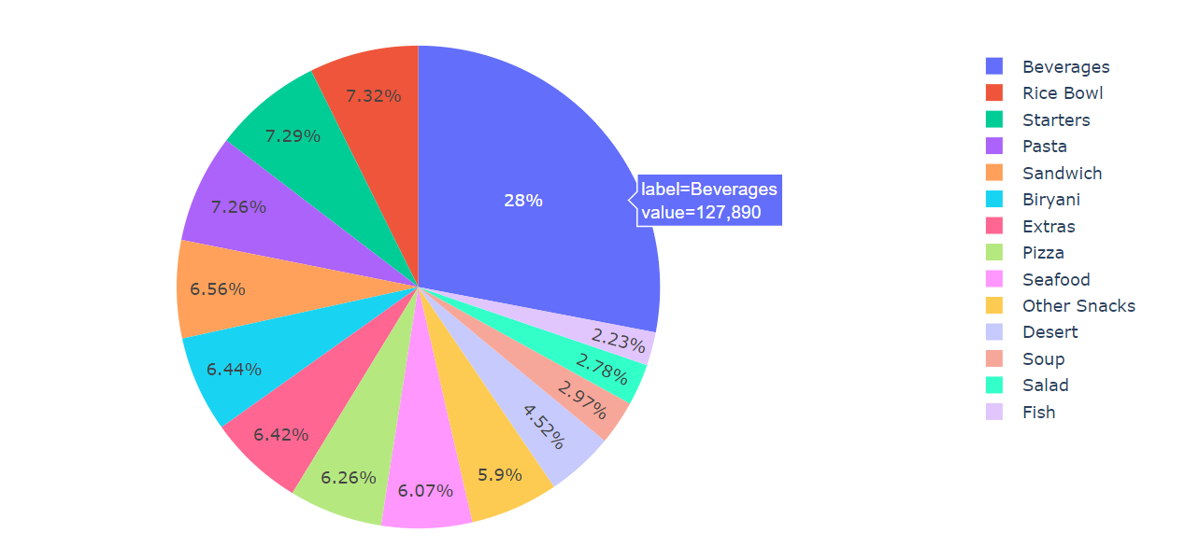
MOST POPULAR FOOD CATEGORY
Beverage is the most popular food category. More than a quarter of the order in the past 146 weeks are beverage related products.

Slide 4
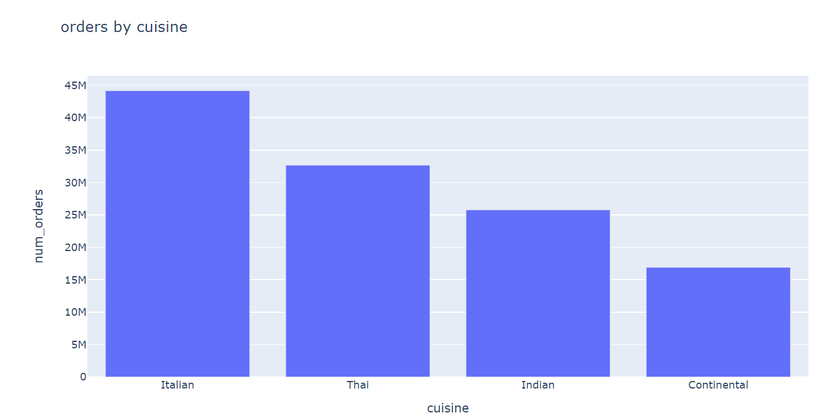
Total ORDER BY CUISINE
Italian cuisines has overall sales of over 44M. Continental is least around 17M

Slide 5
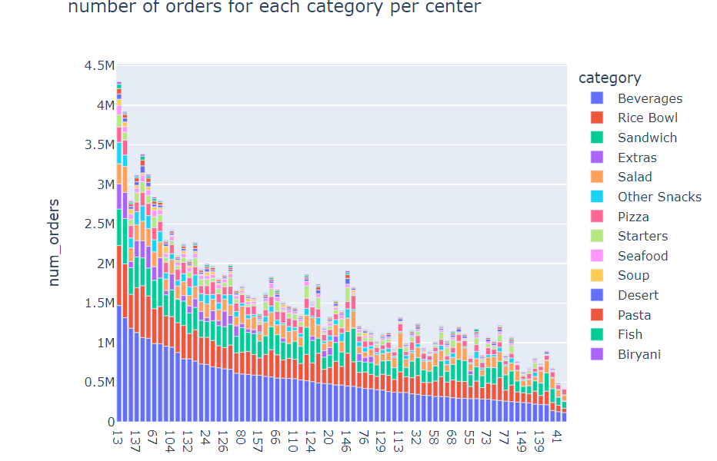
TOP CENTER
Center 10, 43, 10, 52 and 137 are the top 5 center by # Orders.
Beverage and Rice Bowl are the two most popular food category across most of the center

Slide 6
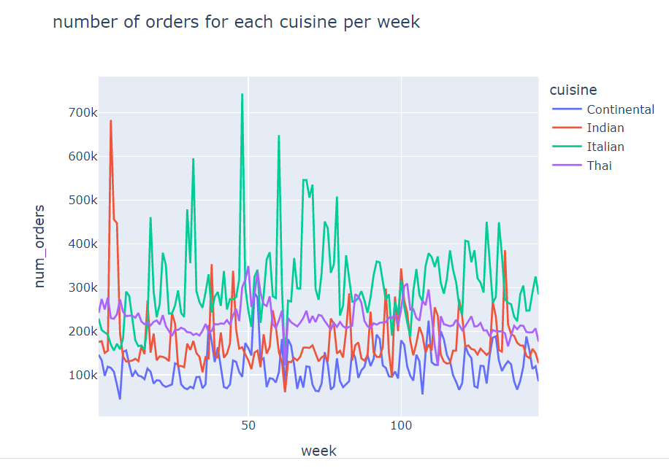
TOP CUISINES TREND
Indian Cuisine was most popular for the initial weeks.
Italian Cuisine has most demand across the 146 weeks analyzed.

